Slide 1

Joint Analysis of Hotel Reviews & Historical Local Economy Metrics for Causal Topics
Alex Kwan
akwan2@Illinois.edu
Team 5
UI ID: 658825907
CS 410

Slide 2
Presentation Overview
Project Goal
Code Walk-through
Initial Results
Potential Next Steps

Slide 3



Project Goal
Predictive model
Predicted values of real world variables
Multiple predictors (features)
Change the world
Economic Indicators
(Non-text data)
Joint mining of non-text and text
Sensor
Hotel Reviews (Text data)
Real World

Slide 4
Project Goal
Question:
Can hotel reviews predict economic indicators of local economies?
How to Answer:
Mine hotel reviews for topics.
Count documents of particular topics.
Use Granger Test to compare Topic Document Count to economic indicators like Gross Domestic Product (GDP)

Slide 5
Code Walkthrough
Data Sources:
Hotel Reviews
From UCI Machine Learning repository
Sampling of Chicago-area reviews
138 hotels from 2001 to 2009
Economic Indicator
From The Open Data Network
Chicago area Gross Domestic Product per capita
From 2003 to 2009

Slide 6
Code Walkthrough
Pseudo-code
Import text from hotel review files into list of texts [lines 58-85]
Extract review text and date of entries from list of texts [lines 90-118]
Use stm package to
Remove stopwords & conduct stemming [lines 124-131]
Estimate appropriate number of topics [lines 134-157]
this section is commented out to make execution shorter
Determine topics [lines 159-165]
Take top topic (topic1) and determine percent prevalence in corpus [lines 169-196]
Import data for Chicago GDP per capita [lines 198-201]
Perform Granger test [lines 205-213]
Plot GDP and topic1 ratio [lines 217-231]

Slide 7
Initial Results
Granger causality test
Model 1: gdppc ~ Lags(gdppc, 1:1) + Lags(ratio, 1:1)
Model 2: gdppc ~ Lags(gdppc, 1:1)
Res.Df Df F Pr(>F)
1 3
2 4 -1 0.8338 0.4285
Causality is NOT demonstrated

Slide 8
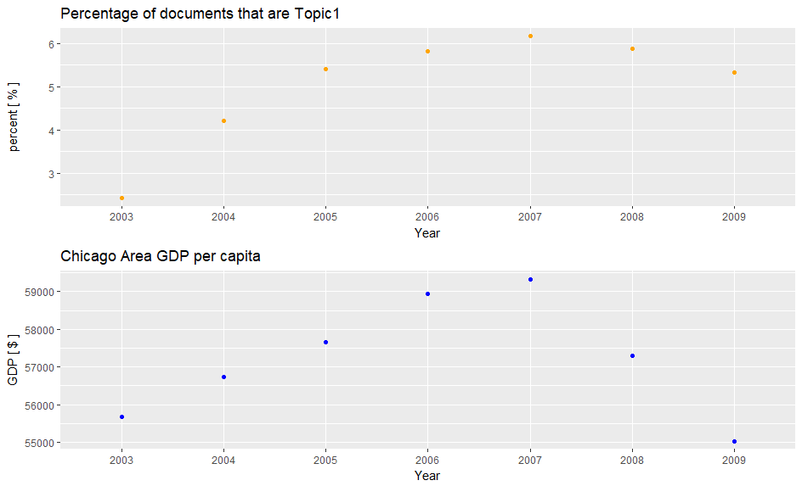
Initial Results

Slide 9
Potential Next Steps
Try with other data
Different Locations (San Francisco, Dubai, etc.)
Different Economic Indicators (Personal Income, Literacy)
Segment data with greater granularity – include seasons
Try with different topics
Implement better data gathering – web scraping

